Slide 1

Fitness Club Management Database Managing Members, Trainers, Classes, and Equipment Effectively
Presented by : Group 7
Yash Palresha
Jahnavi Mavani
Notes:
This presentation showcases a gym management database system designed for handling various aspects such as memberships, trainer assignments, class schedules, and equipment tracking. It demonstrates how SQL and database design principles were applied to create a functional backend for gym operations.

Slide 2

AGENDA
Introduction
Scenario
Entities
Relationships
EER Model
Generalization
Specialization
Queries
Limitations & Lessons Learnt
Conclusion
Notes:
This is an overview of the presentation structure. We will walk through each component of the database from concept to execution, including real SQL queries and insights.

Slide 3

INTRODUCTION
A Fitness Club Management System Database is designed to streamline gym operations. It tracks members, workout schedules, trainers, equipment usage, and maintenance. By integrating attendance, equipment tracking, and session scheduling, it promotes efficient management and improves member satisfaction.
Notes:
The main purpose of this system is to automate and simplify everyday activities in a gym such as registering members, assigning them to sessions, issuing equipment, and keeping a log of all activity. This system helps reduce paperwork, increases transparency, and improves decision-making for gym managers.

Slide 4

SCENARIO
A new member joins the gym, is assigned to a schedule, and is provided workout equipment. Trainers conduct sessions and track attendance. Equipment used is returned and maintained. The system logs all activities, including which staff is responsible.
Notes:
Imagine a member joining the gym. They register, get assigned to either a yoga or aerobics class. Their attendance is logged through the schedule. They may be issued equipment like mats or weights, and trainers are responsible for conducting sessions. The system ensures all this is recorded efficiently.

Slide 5

ENTITIES
Members
Training_Staff
Schedule
Schedule_has_Members
Schedule_has_Trainer
Equipments
Equipment_Issue
Maintanience_Staff
Equipments_has_Maintainence_Staff
Aerobics
Yoga
Gym Training
Notes:
These are the main tables in the database. They represent people (members and staff), assets (equipment), operations (scheduling and attendance), and specialization (aerobics and yoga). Relationship tables like Schedule_has_Members allow many-to-many mappings such as a member attending multiple sessions.

Slide 6
ENTITIES
Members | Training_Staff | Schedule | Schedule_has_Members | Schedule_has_Trainer
Member_id | Trainer_employee_id | Class_id | Member_id (FK) | Trainer_employee_id (FK)
Member_name | Employee_name | Days | Class_id (FK) | Class_id (FK)
gender | Address | Timing
Member_age | Contact no. | Venue
Membership_type | salary | Duration
Contact no. |  | Class size
Address
Start date
End date
Payment balance
Notes:
These are the core components of the system:
Members store personal and membership details.
Training_Staff includes trainers and their qualifications.
Schedule manages class timings and venues.
Linking tables like Schedule_has_Members and Schedule_has_Trainer map many-to-many relationships.
Equipments track gym tools, and their usage is monitored in Equipment_Issue.
Maintenance_Staff handles equipment upkeep.
Aerobics, Gym training and Yoga tables store specific exercise details based on class type.

Slide 7
ENTITIES
Equipments | Equipment_Issue | Maintanience_Staff | Equipments_has_Maintainence_Staff | Aerobics | Yoga | Gym_Training
equipment_id | issue_id | Maintanence_id | equipment_id (FK) | Class_id (FK) | Class_id (FK) | Class_id (FK)
equipment_name | equipment_id (FK) | Maintanence_staff_name | Maintanence_id (FK) | Exercises_taught | Yoga_type | Exercises_taught
equipment_type | Member_id (FK) | Contact_no |  | benefits | benefits | benefits
No._of_Equipments | equipment_issue_date |  |  | contraindications | contraindications | contraindications
Last_Maintenance_date | equipment_return_date
Buoyancy level
Yoga Mat thickness
Punching bag type
Weight stack capapcity
Notes:
These are the core components of the system:
Members store personal and membership details.
Training_Staff includes trainers and their qualifications.
Schedule manages class timings and venues.
Linking tables like Schedule_has_Members and Schedule_has_Trainer map many-to-many relationships.
Equipments track gym tools, and their usage is monitored in Equipment_Issue.
Maintenance_Staff handles equipment upkeep.
Aerobics and Yoga tables store specific exercise details based on class type.

Slide 8
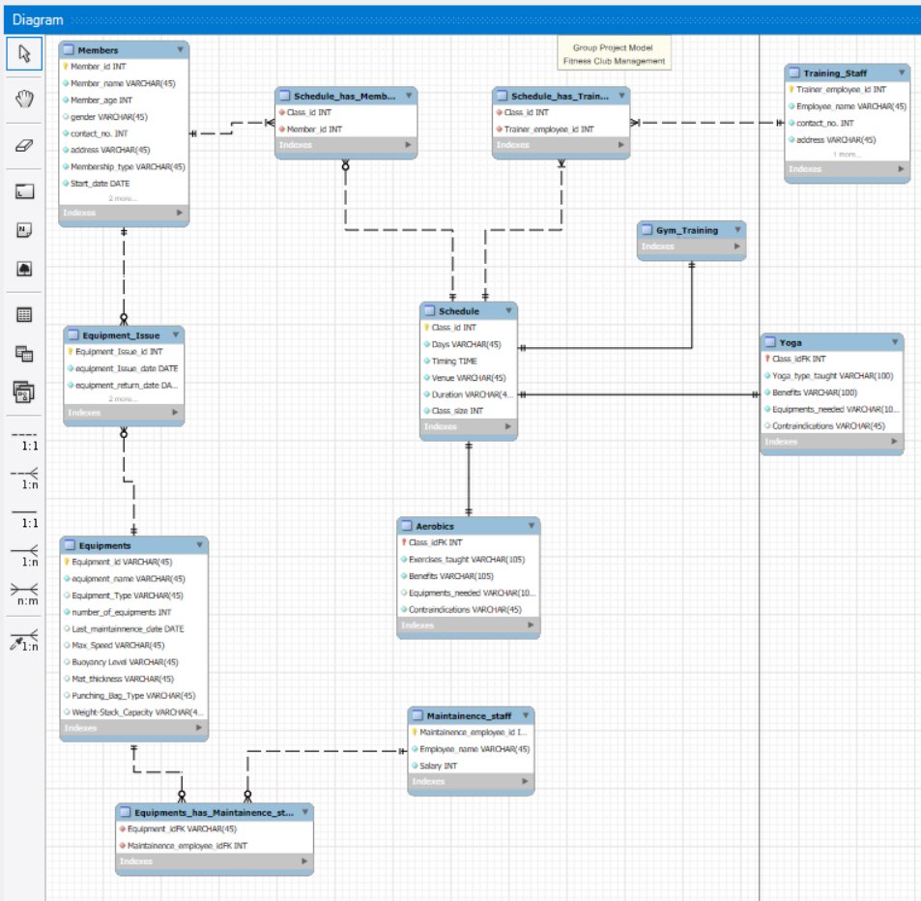
EER Model
Notes:
This is the visual representation of the database. Tables are linked through foreign keys, and generalization/specialization are clearly shown. This model was created in MySQL Workbench and forward-engineered to generate the database schema.

Slide 9
Relationships
Members ↔ Schedule_has_Members (Many-to-Many)
01
Schedule ↔ Schedule_has_Trainer ↔ Training_Staff (Many-to-One)
02
Equipments ↔ Equipment_Issue (One-to-Many)
03
Equipments ↔ Equipments_has_Maintainence_Staff (Many-to-Many)
04
Schedule ↔ Aerobics/Yoga/Gym_Training (One-to-One with specializations)
05
Notes:
Relationships help define how the data is linked together. For example, one piece of equipment can be issued many times, and each class session may have one or multiple members and trainers. These relationships are crucial for writing JOIN queries and understanding data flow.

Slide 10
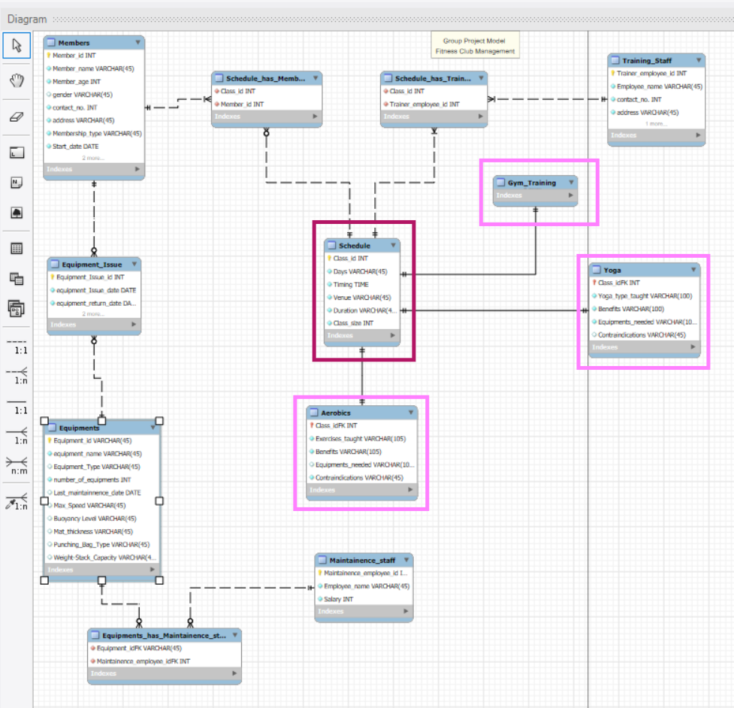
Generalizations and Specializations
Separate Tables for supertype and each subtype
Notes:
This is a more normalized approach, where the supertype has its own table and each subtype has a separate table that references the supertype.
Common attributes are stored only once in the supertype table, and subtype-specific attributes are stored in their own tables.
Example (using Schedule, Gym Training, Yoga, and Aerobics):
Supertype Table: Schedule
Contains shared attributes like:
Class_ID
Timing
Venue
Days
Duration
Class size
These are common across all types of classes (e.g., Gym, Yoga, Aerobics).
Subtype Table: Gym_Training, yoga and aerobics
Contains attributes specific to gym workouts:
Exercise taught/ yoga type
Benefits
Equipments used
Contraindications
Linked to Schedule via Class_ID (foreign key).
Each of these subtype tables (Gym_Training, Yoga, Aerobics) stores only the attributes unique to that class type, while all general schedule-related data is maintained in the central Schedule table.
Pros:
Eliminates redundancy, promotes data consistency by avoiding duplication of schedule information.
Reflects real-world structure well, especially in object-oriented or modular systems.
Cons:
Requires joins between Schedule and each subtype table to retrieve full details of a specific class.
Slightly more complex schema and query logic.
Use this method when:
You expect frequent changes in attributes of specific class types.
You're building a system where flexibility and clear structure are essential (e.g., a gym management system that evolves over time with new training formats).

Slide 11
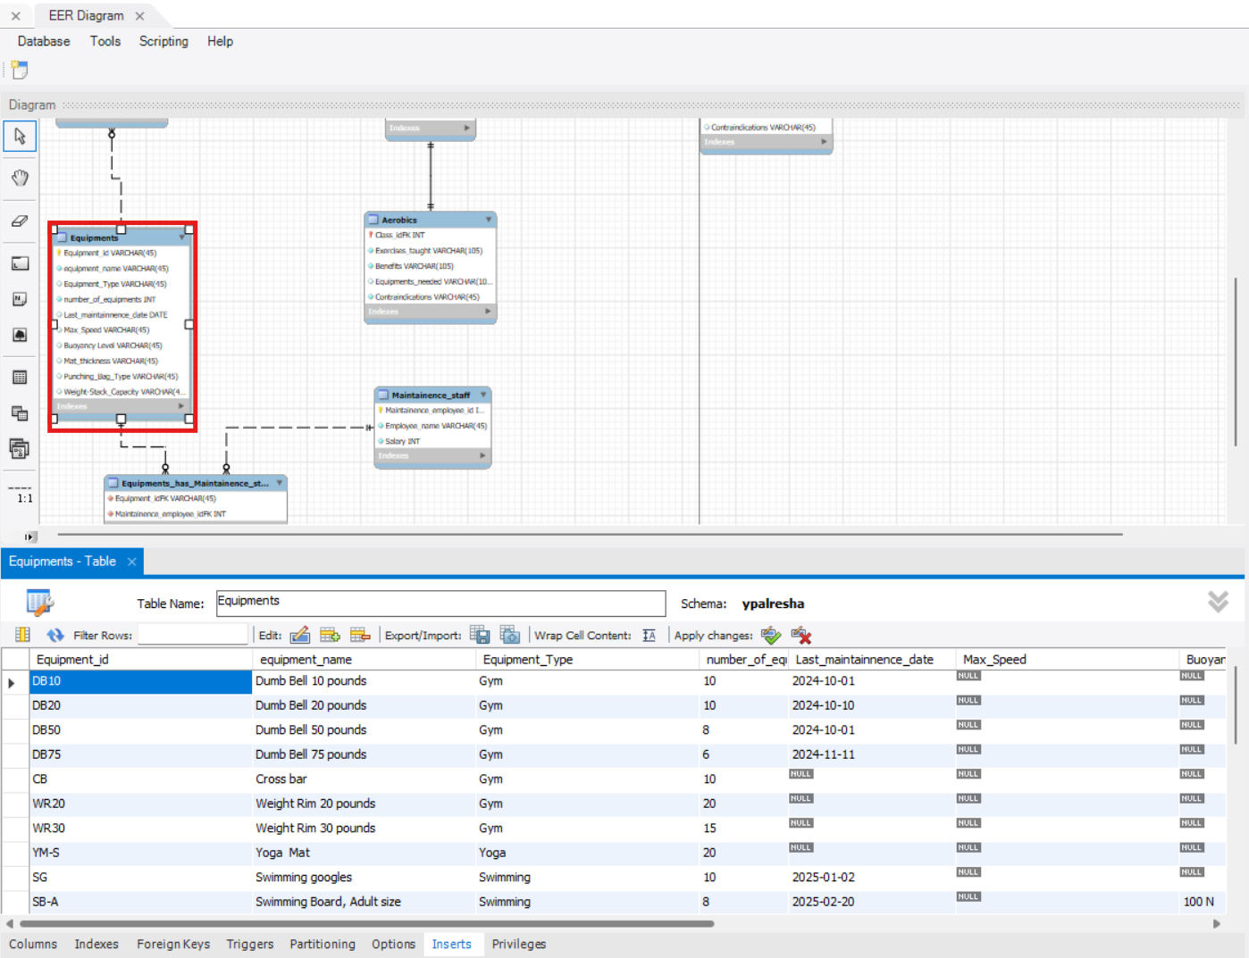
One table allowing nulls for attributes or relationships for each subtype.
Notes:
In this design, only one table (e.g., Equipments) is used to represent both the supertype and all subtypes.
Subtype-specific attributes are included in the table and may contain null values for rows that do not apply to that subtype.
The Equipment_Type field in the example helps identify which subtype each row represents.
Pros:
Simpler schema and fewer joins required.
Easy to maintain and query.
Cons:
Allows nulls in many columns, which can affect data quality and increase storage needs.
Not ideal for systems where subtypes have many distinct attributes.
Use this method when:
Subtypes share most attributes.
Simplicity of design is prioritized over normalization.

Slide 12
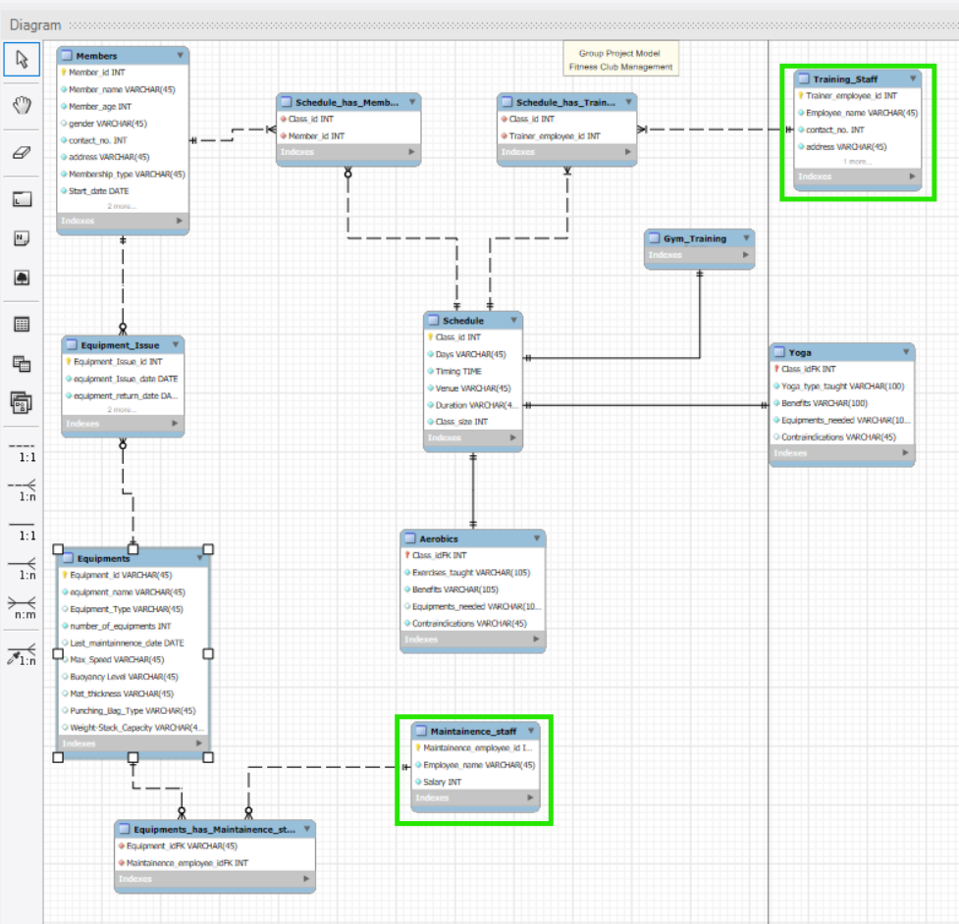
One table for each subtype, repeating attributes for the super type.
Notes:
This approach involves creating separate tables for each subtype, and each of those tables repeats the attributes of the supertype.
For example, in the diagram, Training_Staff and Maintenance_Staff are separate tables that include both their specific attributes and common attributes like Employee_id, Name, etc., which belong to the supertype "Employee/Staff".
Pros:
Easy to access complete data for a specific subtype without the need for joins.
Ensures data integrity within each subtype.
Cons:
Data redundancy: common fields are repeated across tables, which can lead to update anomalies.
More difficult to manage if attributes of the supertype change.
This method is used when:
Subtypes are relatively independent.
Queries are often focused on one subtype at a time.

Slide 13
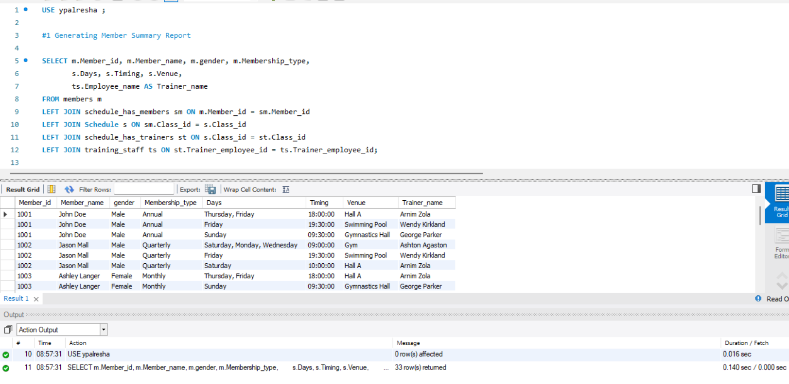
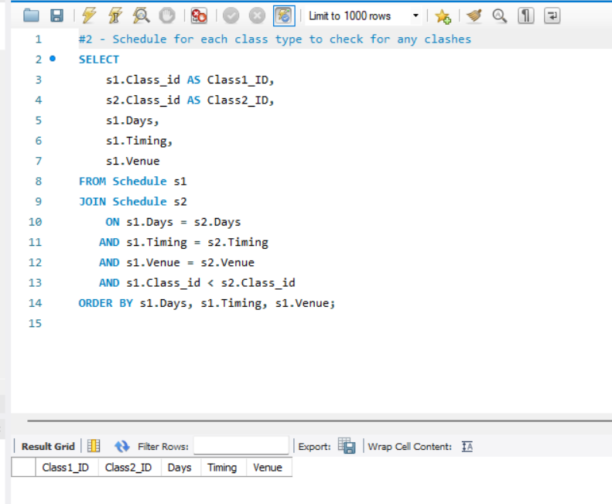
Query 1 :Generating Member summary report
Query 2 : Query to check for any clashes between different classes
Returned 33 rows
Returned 0 rows
Notes:
Query 1 : This query gives an overview of each member’s details, including the classes they’re enrolled in and their assigned trainer. It's essential for staff to manage schedules, identify active members, and provide personalized service.
Query 2 : We use this to avoid any clashes between different classes regarding the timings, days and venue.

Slide 14
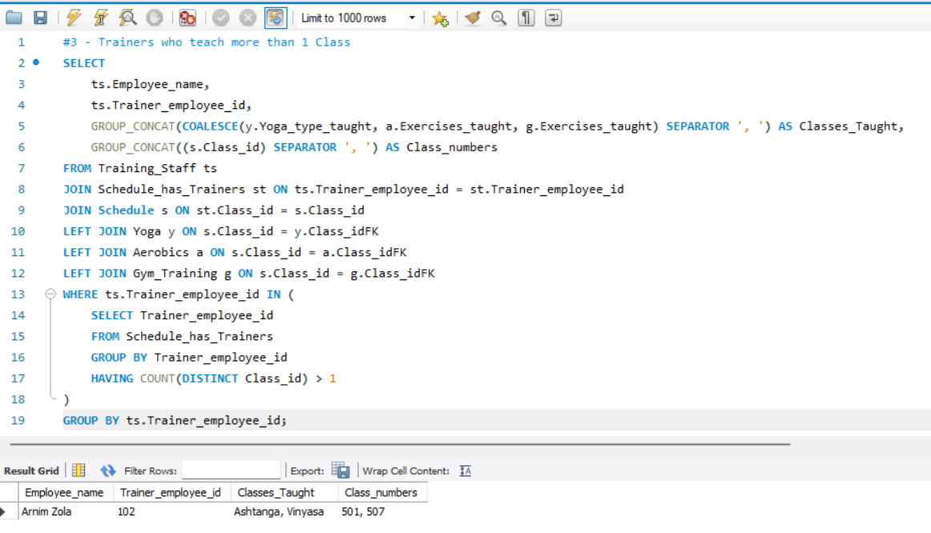
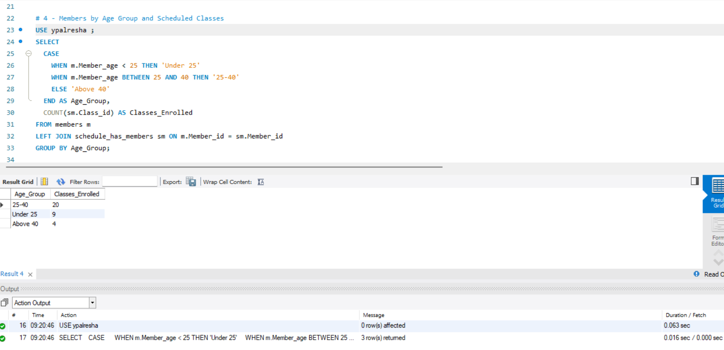
Query 3 : Trainers who teach more than 1 Class
Query 4 :Members by Age Group and enrolled Classes
Returned 1 rows
Returned 3 rows
Notes:
Query 3 : This helps gym managers identify underutilized trainers. It supports fair workload distribution and efficient human resource planning.
Query 4 : This groups members by age and shows class participation. It’s important for tailoring gym offerings to specific demographics and understanding age-wise engagement.

Slide 15
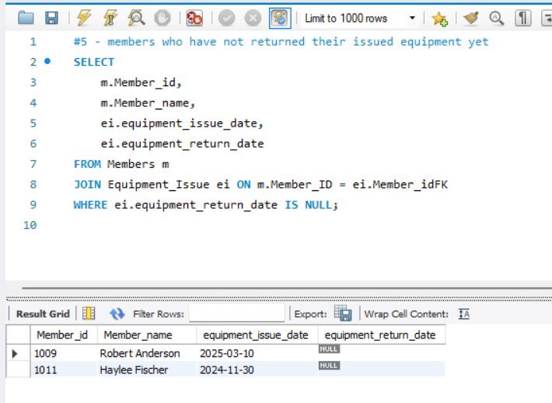
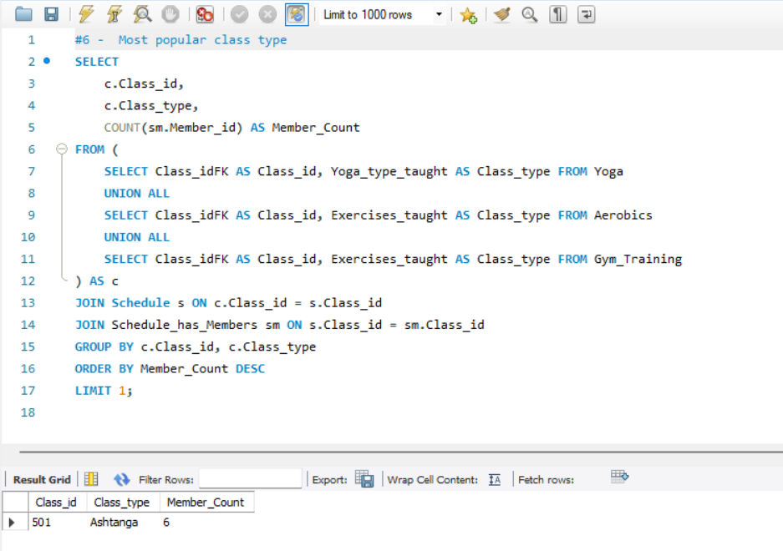
Query 5 : Members Who Have Not Returned Issued Equipment
Query 6 : Most Popular Class Type
Returned 2 rows
Returned 1 row
Notes:
Query 5 : This finds members who still have gym equipment. It prevents losses and ensures equipment is available for others. Very useful for operational control.
Query 6 : This compares enrollment in Different Fitness activities. It helps identify member preferences and guide marketing or scheduling decisions.

Slide 16
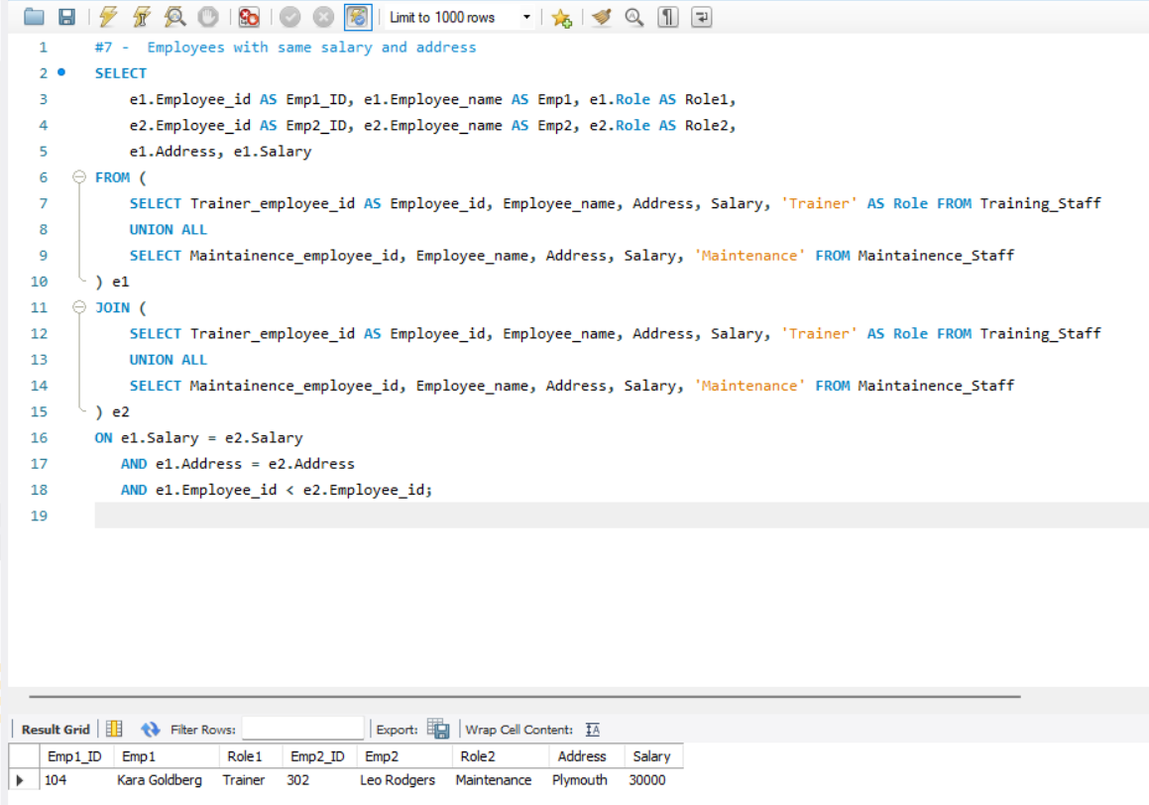
Query 7 : Employees with same salary and living in same area
Returned 1 row
Notes:
Query 7: shows employees with same salary and address, helps in understanding employee distribution, improving management decisions, and ensuring data integrity in the fitness club.

Slide 17
Limitations
No feedback system for classes.
Equipment issue dates are tracked, not real-time condition.
No biometric attendance integration.
Limited to one location (no multi-branch logic).
Notes:
While the database handles core operations well, it lacks certain advanced features like real-time equipment monitoring or feedback from members. These can be considered for future upgrades.

Slide 18
Lessons Learnt
Build
Build parent tables first (e.g., Members before relationships).
Maintain
Maintain clear foreign key links.
Normalize
Normalize but balance performance.
Name
Name tables and columns consistently.
Notes:
Build parent tables first: It’s crucial to create foundational or parent tables like Members, Training_Staff, and Equipments before setting up junction tables like Schedule_has_Members or Equipment_Issue. This ensures foreign key constraints are applied correctly and avoids integrity errors during forward engineering.
Maintain clear foreign key links: Each relationship was built with proper foreign key constraints, enabling referential integrity. This not only prevents orphan records but also ensures that all operations (INSERT, DELETE, UPDATE) reflect accurately across linked tables.
Normalize but balance performance: The database was normalized to reduce redundancy—for example, storing equipment condition separately instead of repeating it with each issue. However, we avoided over-normalizing, which could lead to excessive JOINs and slower queries.
Consistent naming conventions: Table and column names were kept meaningful, lowercase, and underscore-separated for better readability. This made writing SQL queries easier and debugging faster. Consistency in naming also makes documentation and teamwork smoother.
These practices laid the groundwork for a maintainable, scalable, and efficient system that aligns with real-world database design standards.
During development, we learned the importance of establishing a logical order for creating tables. Proper use of constraints and naming helps future maintenance and collaboration.

Slide 19
Conclusion
This Fitness Club Management System provides a strong foundation to manage schedules, trainers, equipment, and members. Though some advanced features like mobile syncing or feedback are not implemented, the system is scalable and functionally complete.
Notes:
The gym management database supports a wide range of operations, from member tracking to trainer scheduling and equipment management. Although simple, it builds a strong foundation for future features like mobile integration, biometric attendance, and real-time updates. It fulfills the goal of improving operational efficiency and member satisfaction.

Slide 20

THANK YOU !

